Slide 1


Slide 2

#LifeKoKaroLift
SGC Coaching:
Articulate your Journey | Activate Students’ Vigour| Accelerate Mutual Growth
Session 8
Logistic Regression

Slide 3
Agenda
Quick Recap –(10 mins)
Focused Discussion –(60 mins)
Doubts Resolutions–(20 mins)
Last 2 weeks
Deep-Dive: Classification / Logistic Regression
Topical understanding

Slide 4
Recap: What the learner have learnt in the week
Classification Technique
Binary classification
Logistic Regression
Univariate
Model Interpretation
Accuracy check
Decision Boundaries
Multivariate
Logit Concept
Performance tuning
Business results
Quick Glance at Key Learnings

Slide 5
Focussed teaching: Plunge into the classification..
Classification vs. Regression: Use case, technique differences
Technique related considerations (computation of probability, logit, sigmoid)
Model Evaluation methods
Coding Time

Slide 6
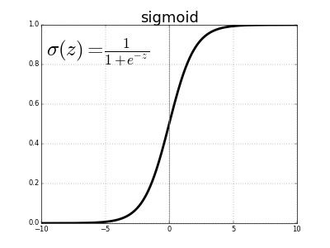
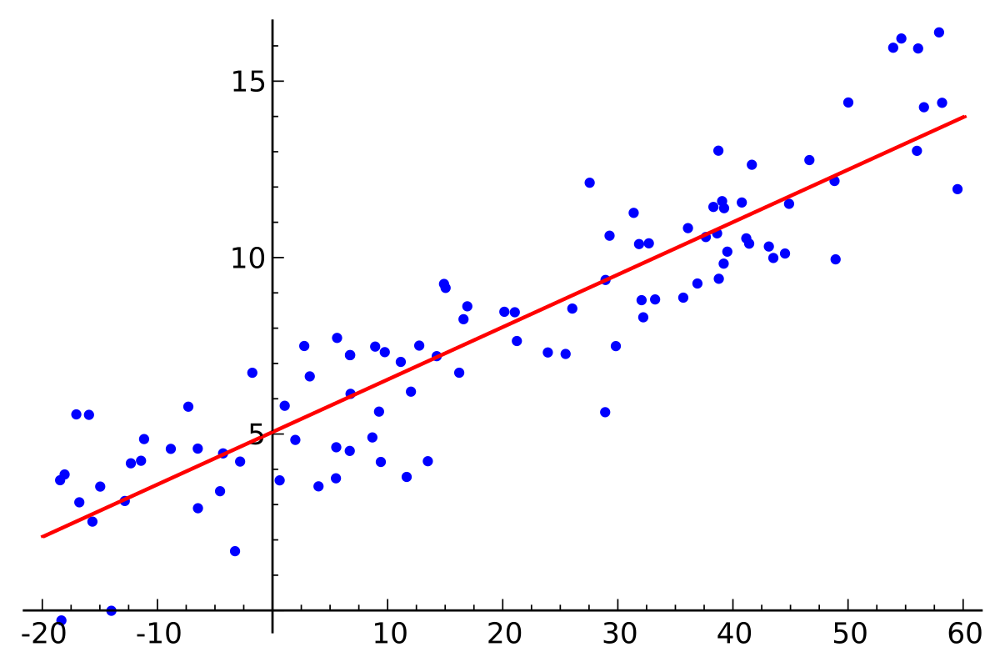
Logistic vs. Linear Regression
Y = ß₀ + ß₁x_{1.....} + ß_{n}x_{n}
Combination of diagnostics and statistical approach to arrive at most optimum model.
Discuss actionability of parameters as an outcome of the model
Notes:
Comparison of the two in terms of expected output and technical differences
You can help the learners with no experience about how it impacts in business sense as per type of problems it solves.
Also calculation of how the equation translates into 0 and 1.

Slide 7
Technique Considerations (Concept & application)
Train/Test
split
Reduce class bias from the data
Train and test data must be spread evenly
Logit models
Feature Selection using RFE and other statistic tests
Calculating odds using ln(p/1-p)
Model validation
Confusion matrix
Optimize Model
ROC Curve
Maximizing the probability
Notes:
Please use your notebook to share example for these steps.
Detecting optimal cutoff threshold for better accuracy.
optimal_idx = np.argmax(tpr - fpr)
optimal_threshold = thresholds[optimal_idx]

Slide 8
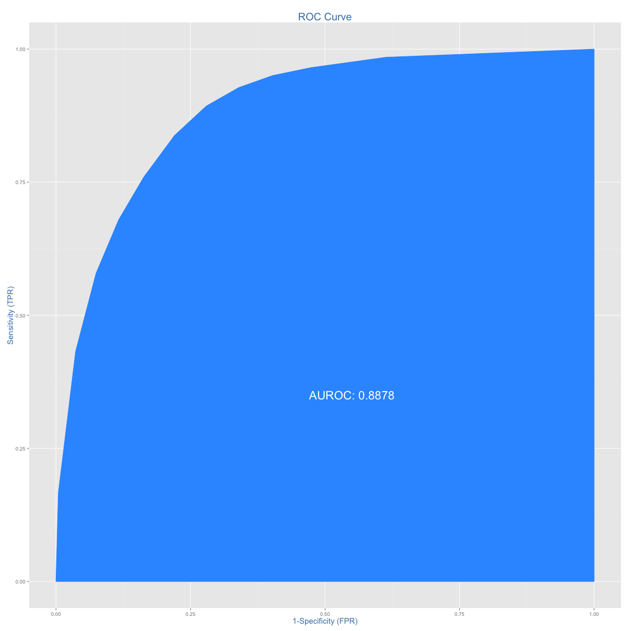
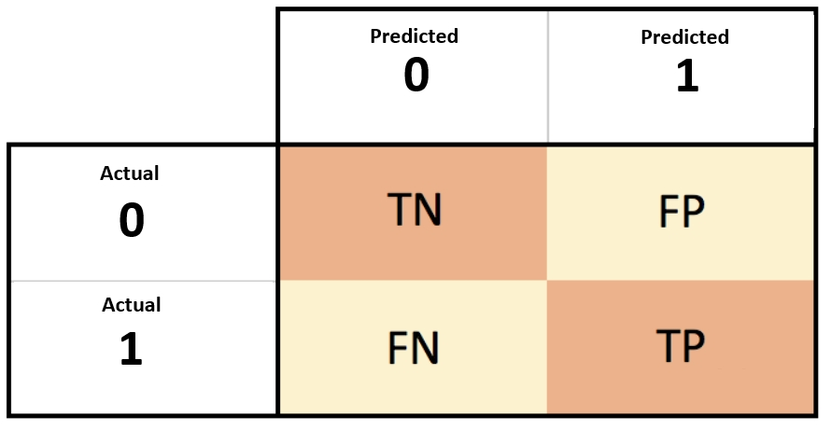
Model Evaluation methods
Confusion matrix
ROC Curve
Confusion matrix: Comparing prediction errors
Which error is more concerning? (FP or FN)
Comparing sensitivity and specificity.
Confusion = confusion_matrix(y_true, y_pred)
False Positive FP = confusion[1,0]
False Negative FN = confusion[0,1]
ROC Curve: Model discriminating power
The further the curve is from the diagonal line, the better the model is at discriminating between positives and negatives in general.
It checks both sensitivity and specificity.
roc_curve(y_true, y_score)
Notes:
Show your own outputs in coding and explain each outcome carefully.

Slide 9
Focussed teaching: Let’s Code Together
Coding Time

Slide 10
Focussed teaching: Quiz Time
Quiz Time
Notes:
https://forms.gle/f4VMgt1GdEwXrbhL8

Slide 11

Doubt resolution
Address Questions
On Technique
On Applications
Anything else
Notes:
Encourage Within group Interactions

